Slide 1









VORTEXA
3.0
12 HRS HACKATHON
POWERED BY A.I.R.S
DOMAIN & NO : 6, P-01
PROBLEM STATEMENT TITLE : RationSaathi: Public Distribution Entitlement & Dispute Assistant
TEAM NAME : Code Alchemists
TEAM ID : VTX26-25624

Slide 2

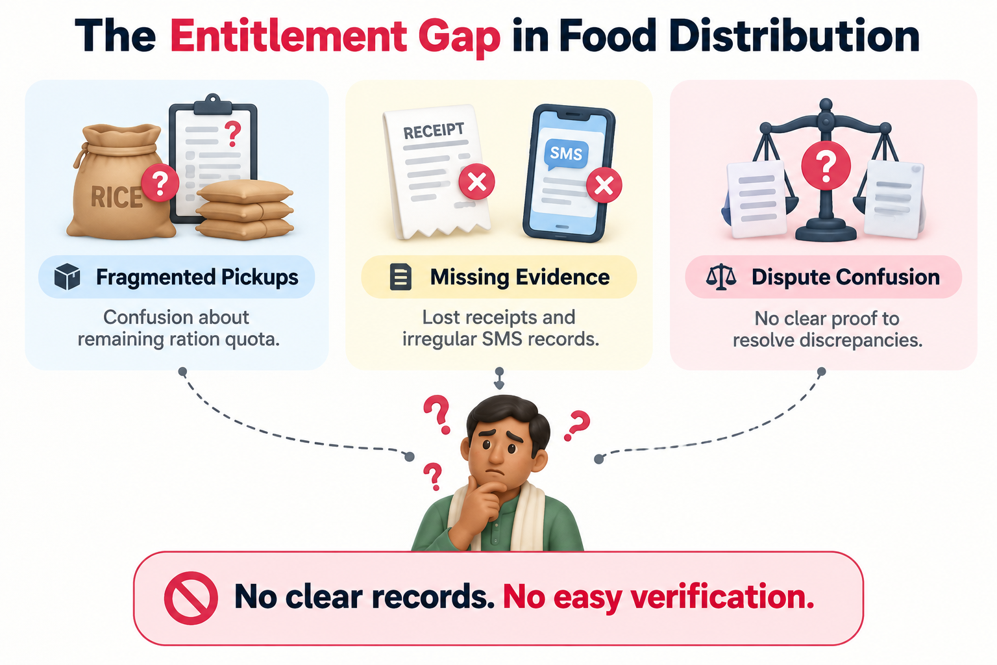

PROBLEM STATEMENT
Problem: Lack of transparent and accessible ration entitlement tracking under the Public Distribution System (PDS).
Beneficiaries struggle to track their entitled and received ration quantities.
Paper receipts may be lost, damaged or difficult to understand.
Partial collections and stock shortages create confusion about remaining entitlements.
Citizens often lack organized evidence to communicate discrepancies effectively.
Need: A simple, reliable system to compare ration entitlements with recorded collections and generate evidence-based reports.

Slide 3
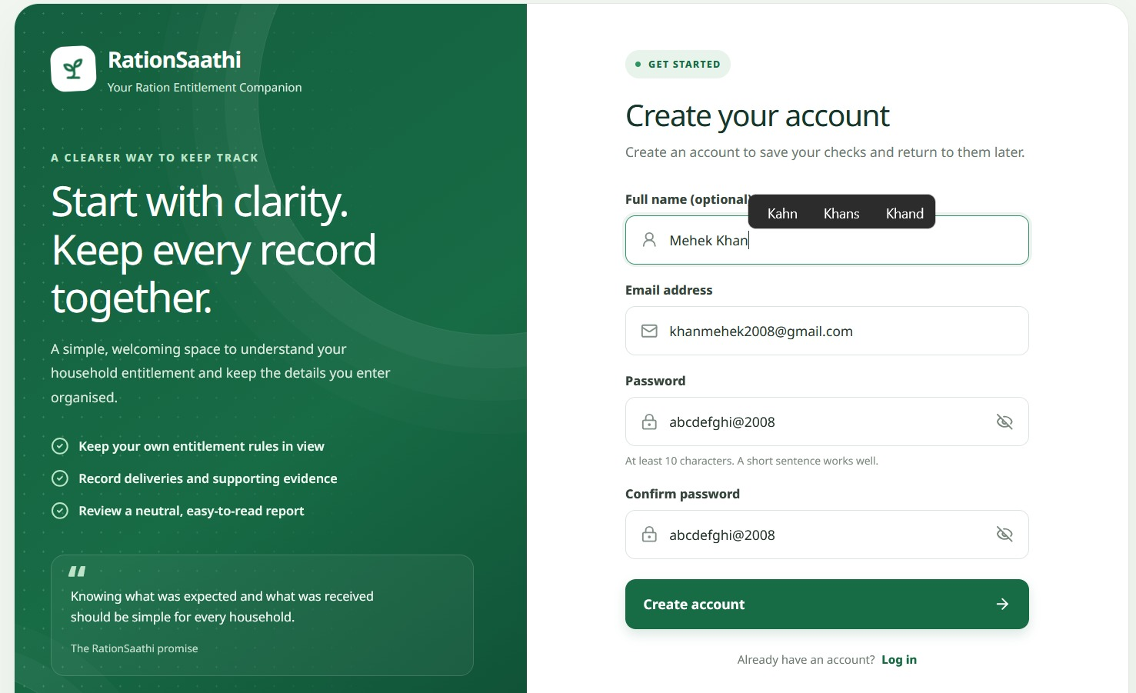
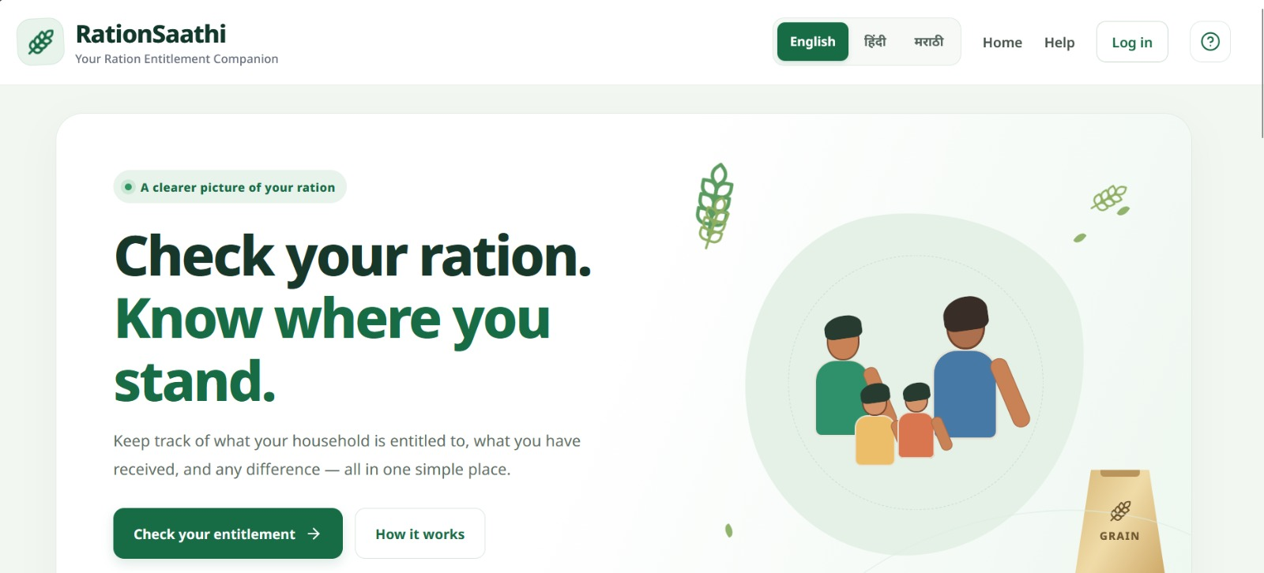
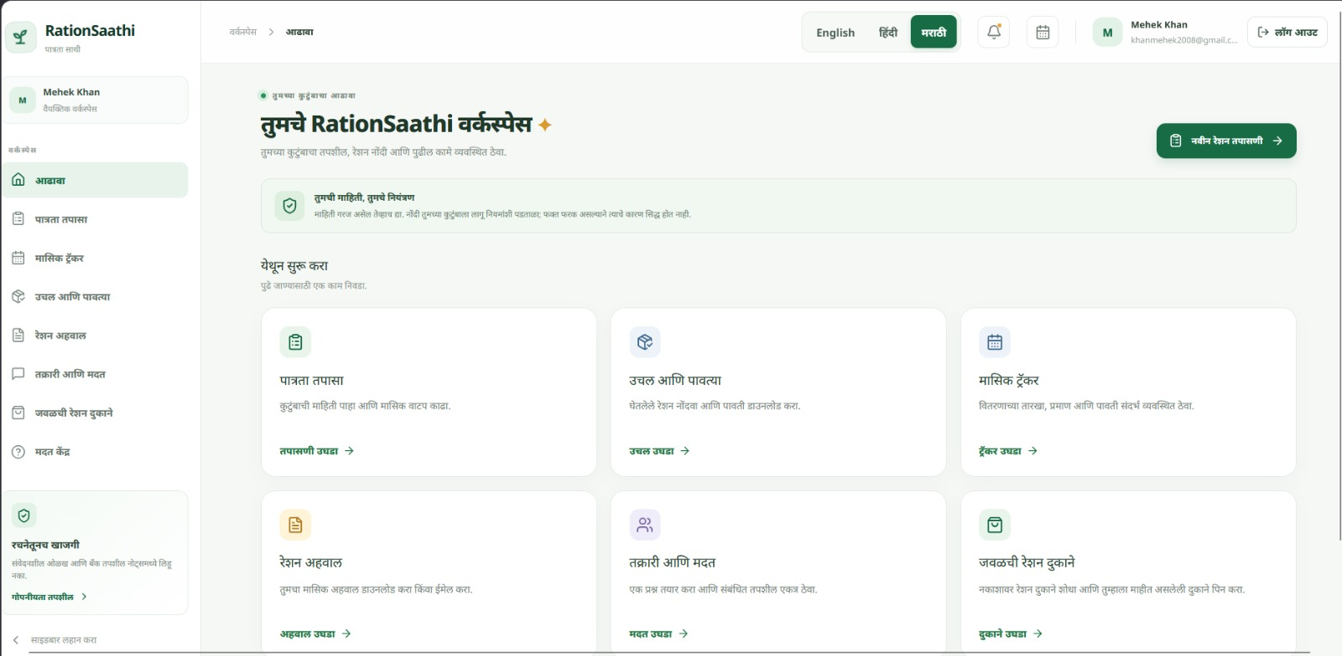
IDEA TITLE / PROPOSED SOLUTION
Proposed Solution: RationSaathi
RationSaathi is a multilingual civic assistant that helps beneficiaries track their ration entitlements, record collections and identify quantity discrepancies.
Key Features
Family-based entitlement and quota tracking.
AI-assisted extraction of quantities and dates from receipts or SMS text.
User verification before records are included in calculations.
Automated discrepancy reports with supporting evidence.
English, Hindi and Marathi language support.
Objective: Promote transparency and informed, non-confrontational grievance reporting.

Slide 4
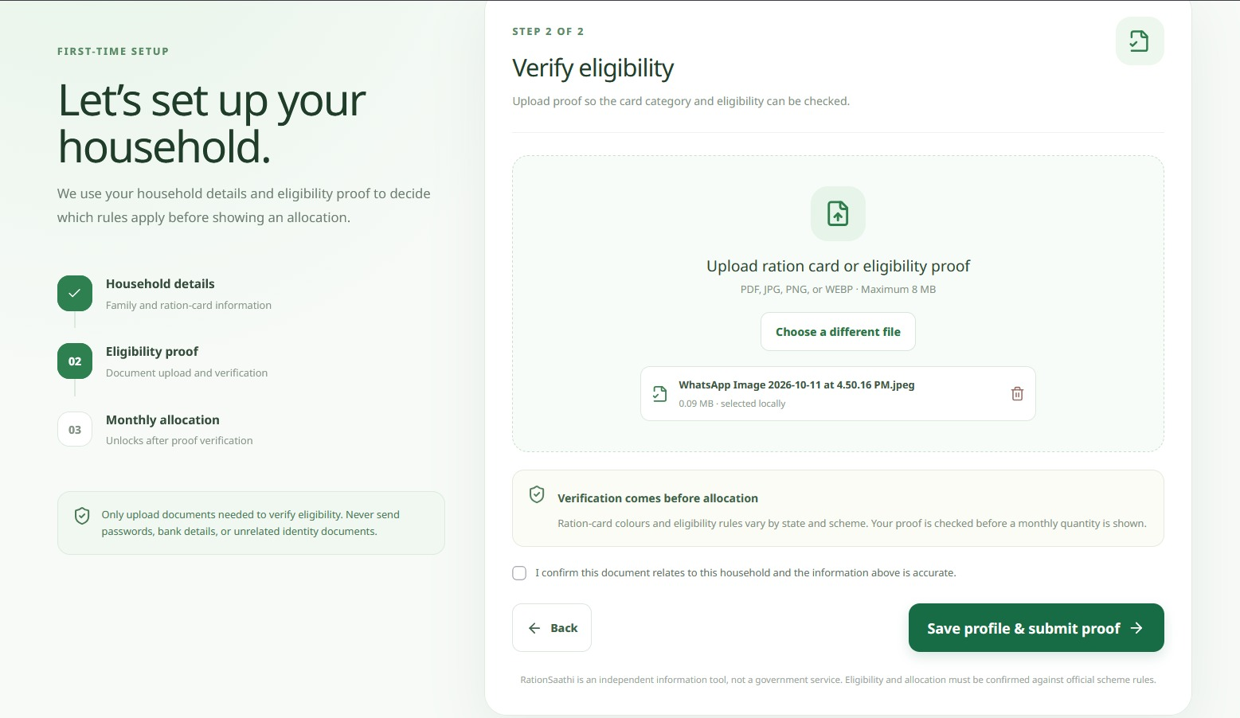
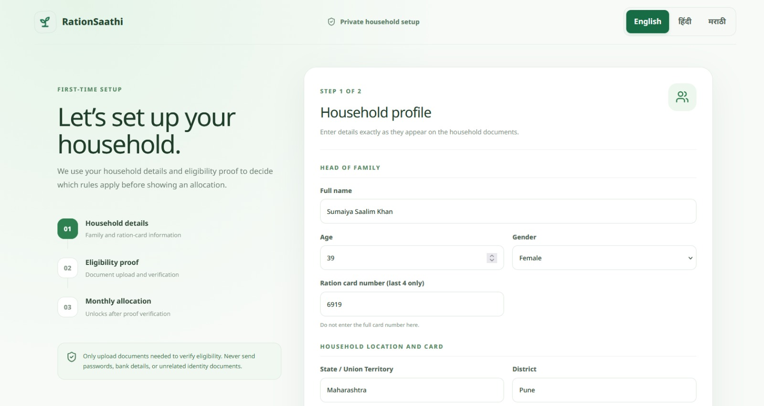
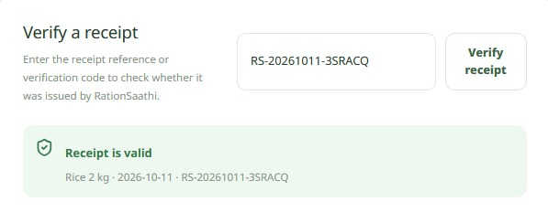
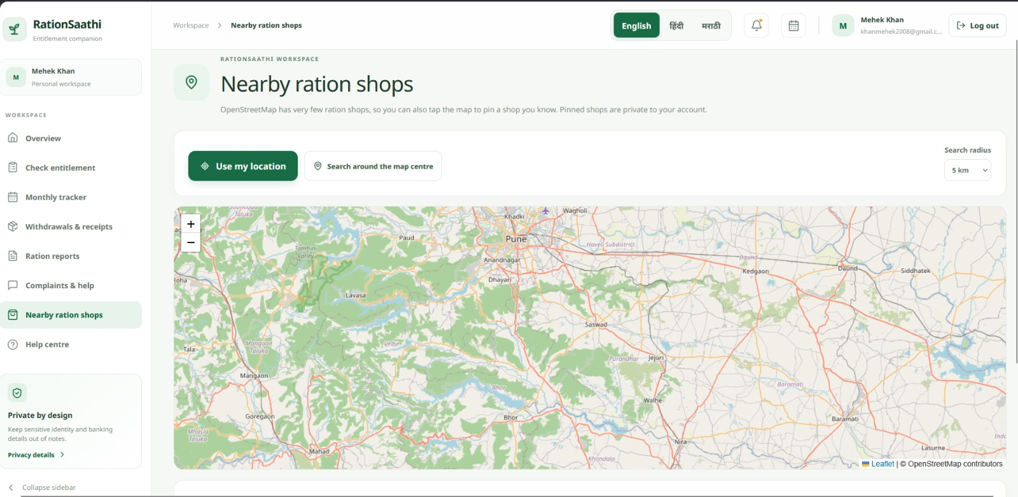
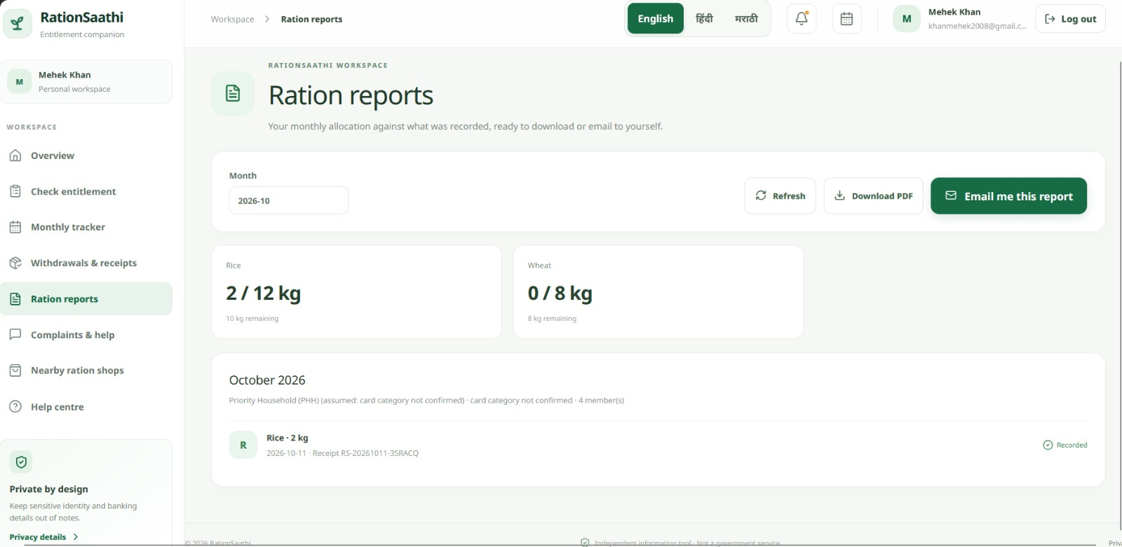
IDEA TITLE / PROPOSED SOLUTION

Slide 5
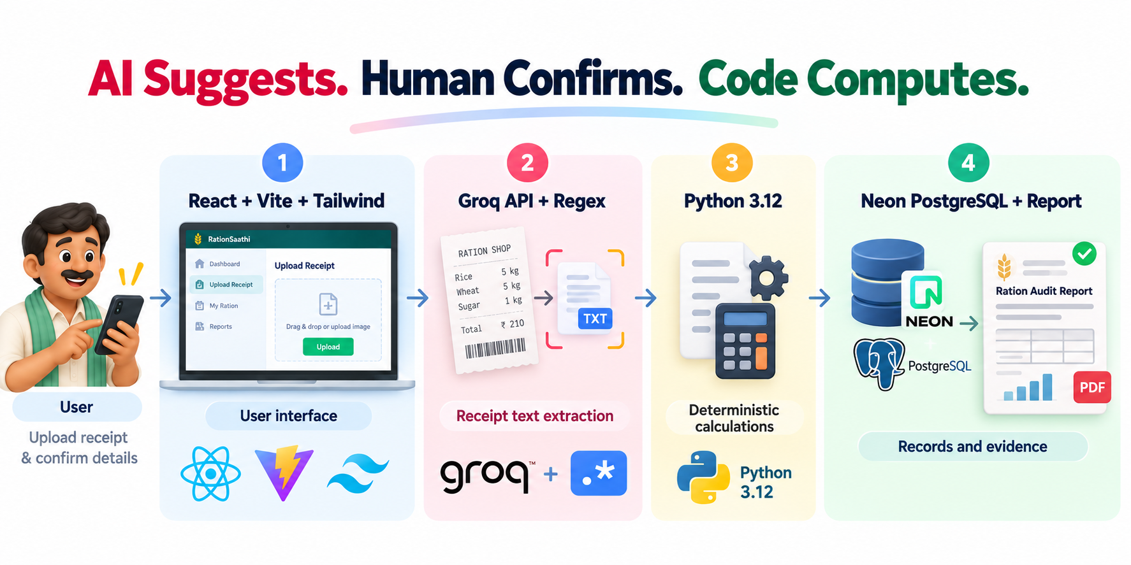
TECHNICAL APPROACH
Workflow
Enter family details and entitlement rules.
Extract receipt information and verify suggested values.
Calculate expected, received and remaining quantities using deterministic logic.
Generate a neutral report with linked evidence.

Slide 6
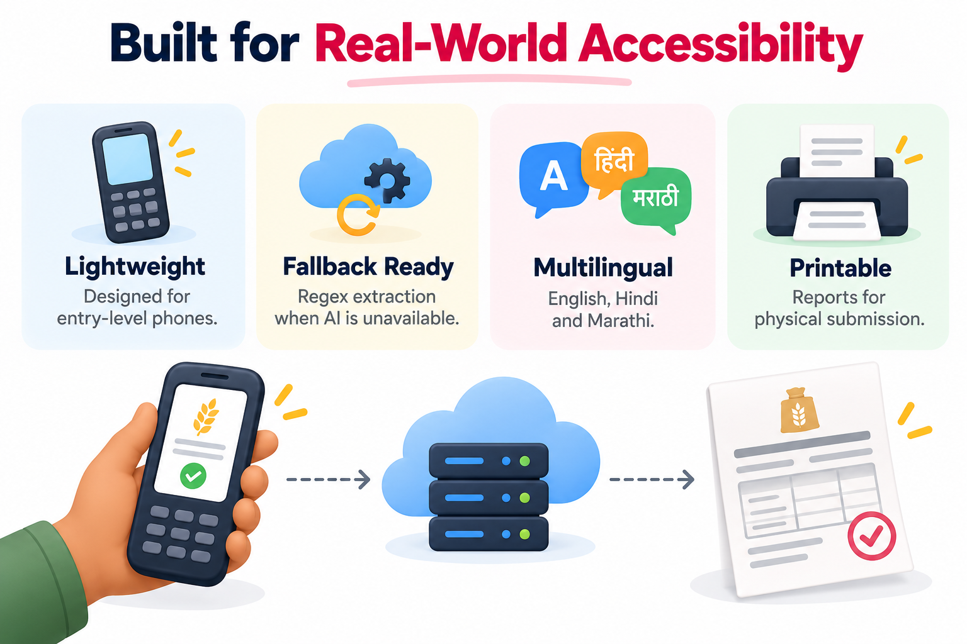
FEASIBILITY AND VIABILITY
Technical Feasibility
Uses established web technologies and structured calculation rules.
Supports Regex-based receipt extraction when AI processing is unavailable.
Designed for responsive use on mobile devices.
Operational Feasibility
Simple data-entry and receipt-verification workflow.
Multilingual interface for improved accessibility.
Printable reports for record-keeping and grievance submission.
Economic Viability
Cost-effective
Social value
User adoption
Scalability
Long-term potential

Slide 7
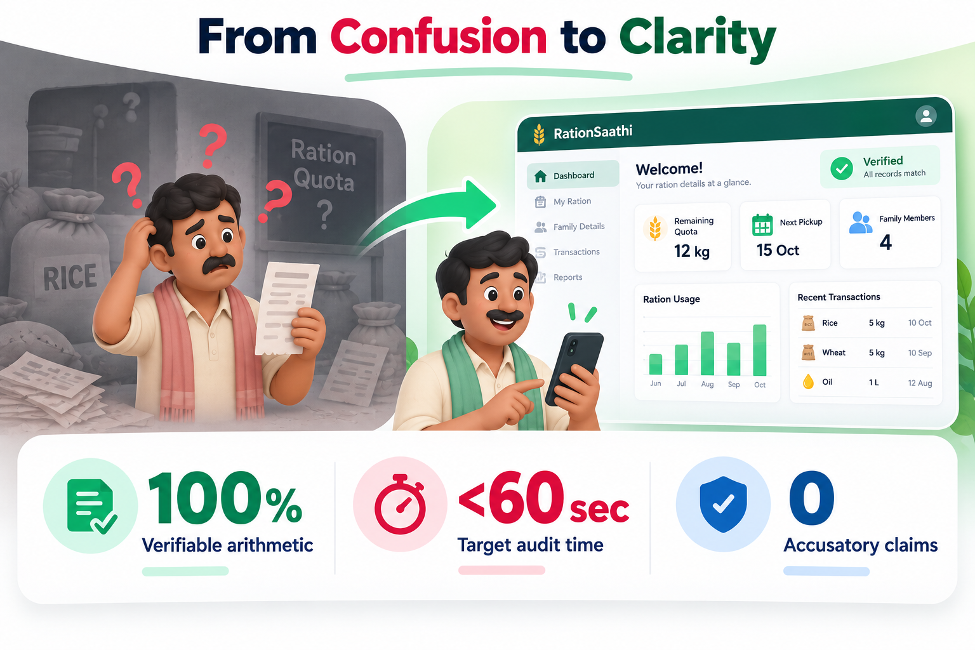
IMPACT AND BENEFITS
Benefits for Beneficiaries
Entitlement Clarity
Receipt Management
Accurate Calculations
Multilingual Accessibility
Time Saving
Provides Accurate Report
Impact of RationSaathi
Improved Transparency
Constructive Dispute Resolution
Protection Against False Allegations
Beneficiary Empowerment

Slide 8
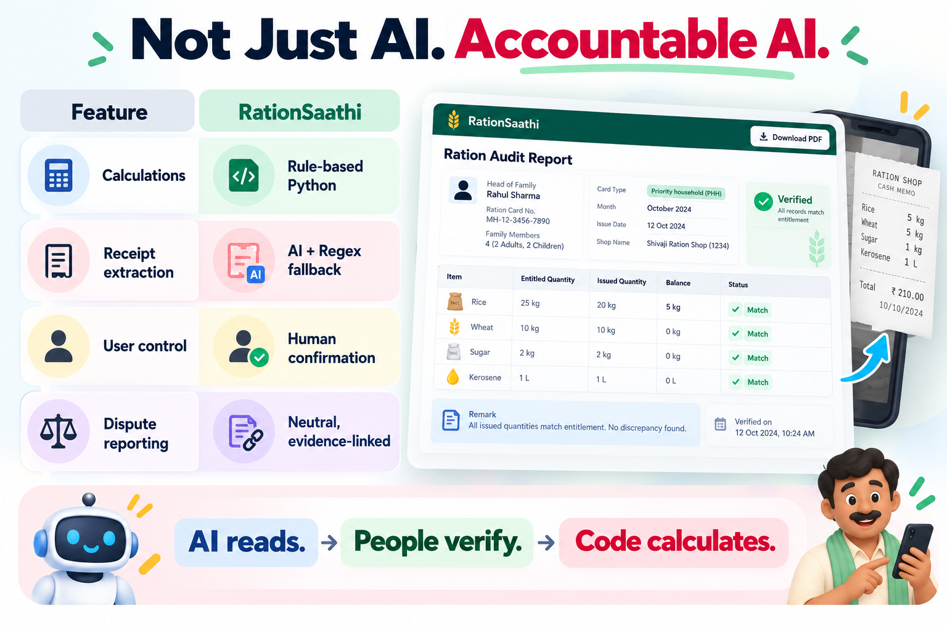
DIFFERENTIATOR
What Makes RationSaathi Different?
Authenticates Beneficiaries
Automatic Allocation of Entitlement
Accurate Tracking of Resource Entitlement
Receipt Proof Verification and Validation.
Monthly Tracker
Locates Nearby Shops.
Key Differentiator: A transparent, user-controlled approach to ration verification that combines AI assistance with deterministic calculations.

Slide 9










THANK YOU!
Game’s
Still On
VORTEXA 3.0
AIRS

